Slide 1
1996 vs. 2025
1996
2025
Book
Pascal
Assignment pen & paper
Google
Youtube
AI
Intelligent IDE
C++
Notes:
Interesting observation

Slide 2
Assignment 2

Slide 3
Assignment 2 – Company Adds on LCD
Started with template:
lafftale1999/cpp_embedded_assignment: Template for the graded assignment regarding the embedded objectives of the "C++ for developers" course.
Uploaded and tested code on: https://wokwi.com/projects/445497618841194497

Slide 4
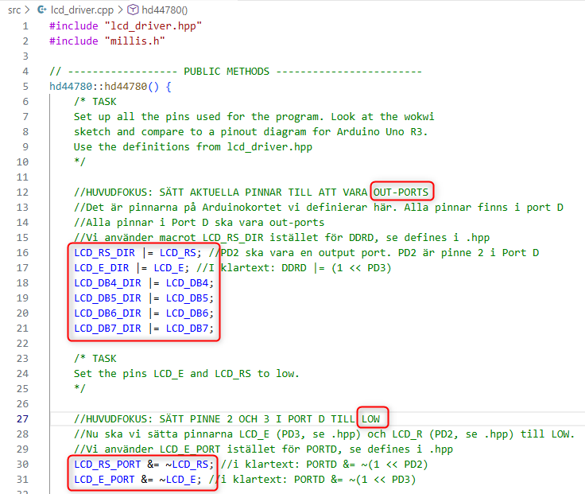
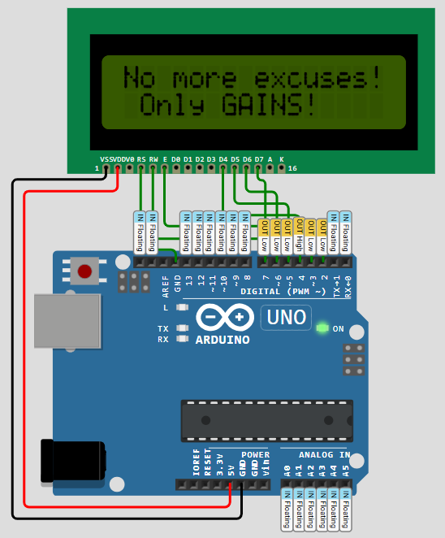
Lcd_driver.hpp
Used macros defined in lcd_driver.hpp to setup pins (2 – 7) on the Arduino
Step 1: define all as out ports
Step 2: set pin 2 and 3 to LOW

Slide 5
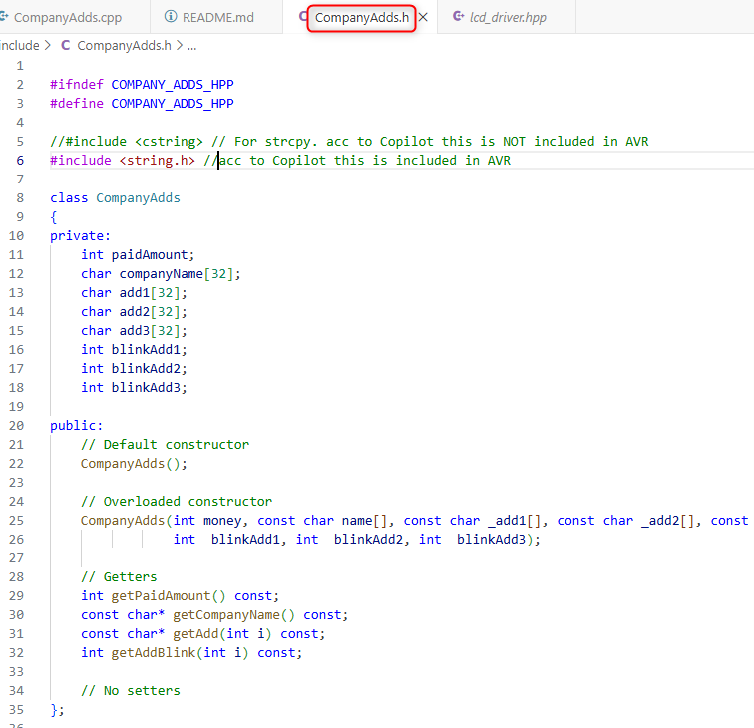
Class CompanyAdds
Class CompanyAdds contains all information for a company:
- Paid amount
- Company name
- Company adds (3)
- Add blink info

Slide 6
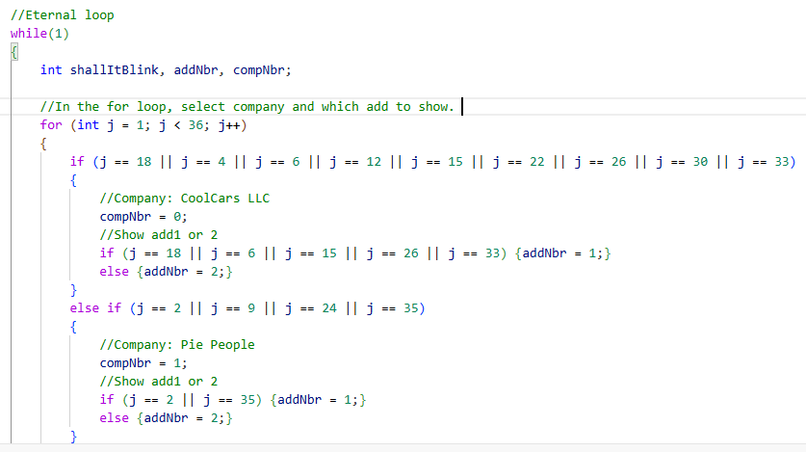
Selection of add to show
Assumes 35 commercial slots in each eternal loop
Based on what the company has paid they get a number of slots (3 to 11)
Runs a for loop in each while loop
and add is selectedIn the for loop both company
…Could of cause be done in a nicer way…

Slide 7
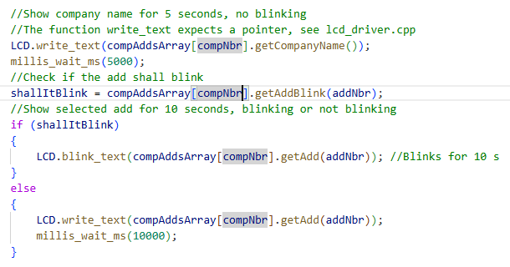
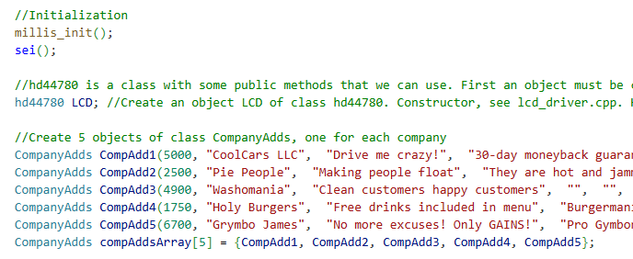
main.cpp
Init:
- Create an instance LCD of class hd44780
- Create 5 instances of class CompanyAdd. Put them in an array
Eternal loop:
Show company name for 5 s
Check if add shall blink
Show add for 10 s, using method blink_text or write_text

Slide 8
Assignment 1

Slide 9
Assignment 1 – Secure card system
Implementation done in a traditional way with a state machine representated by enumeration values
In each state different functions performs the tasks
Intentionally done in a C style way, not including to compilcated C++ functionality

Slide 10
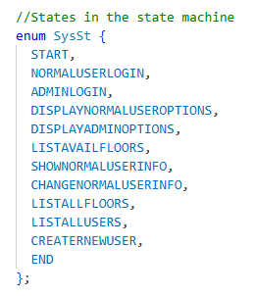
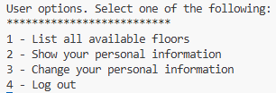
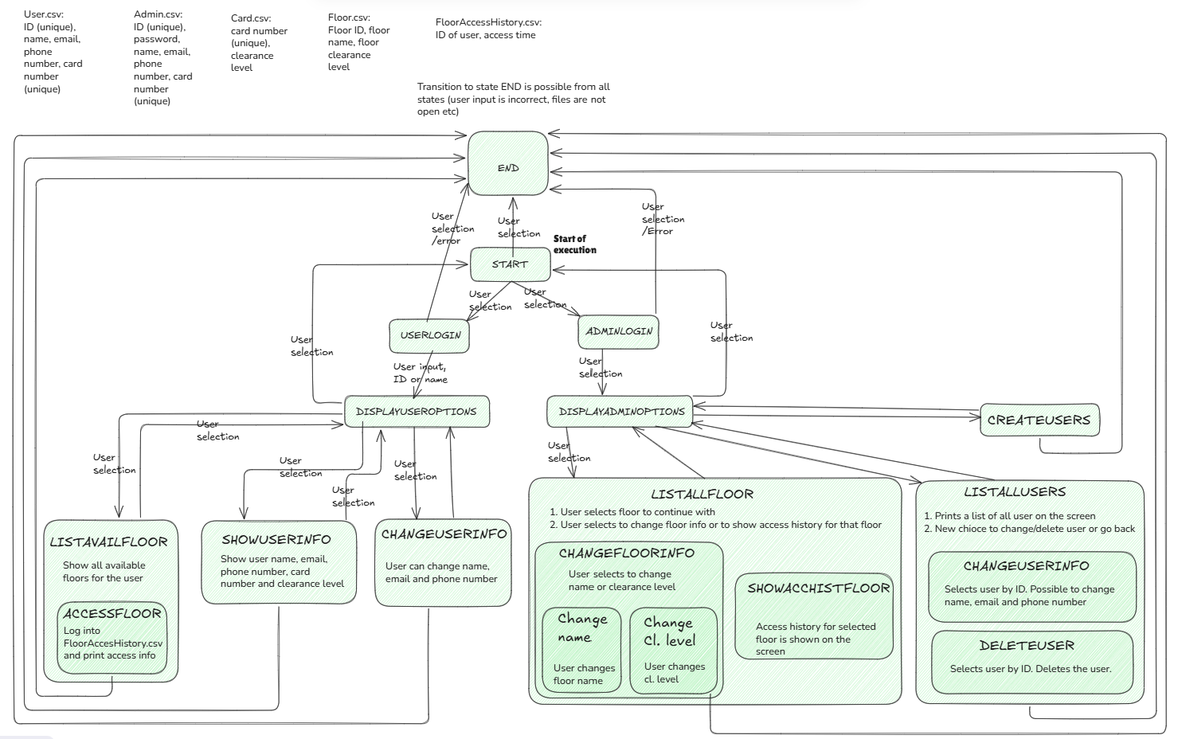
State machine

Slide 11
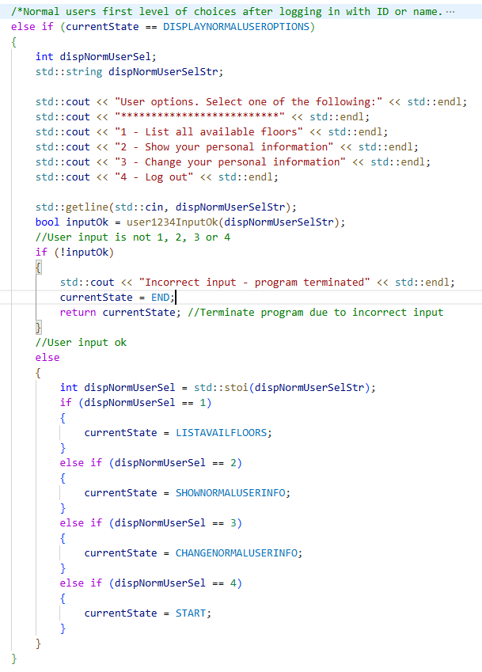
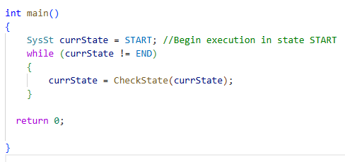
State machine
State machine (CheckState();) is called from main in an eternal loop
State machine consists of several else if statements
We are in a state, checking if a transition to another state shall occure
User input is mainly handeled in the state machine

Slide 12
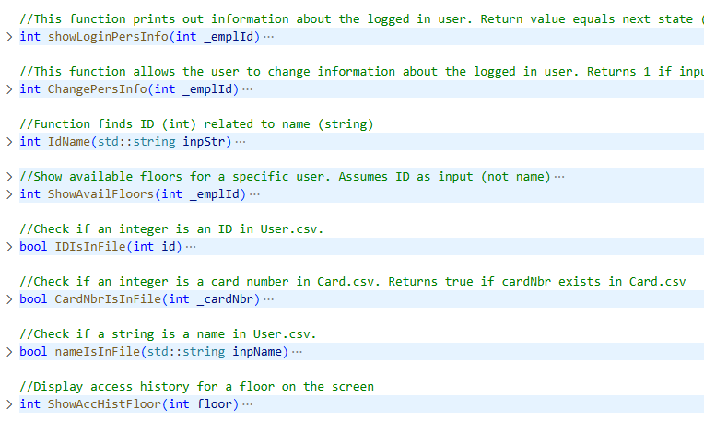
Seccardsysutils .h / .cpp
Contain functions that performs a specific task, e.g. show user information, find ID corresponding to a user name, change floor name etc

Slide 13
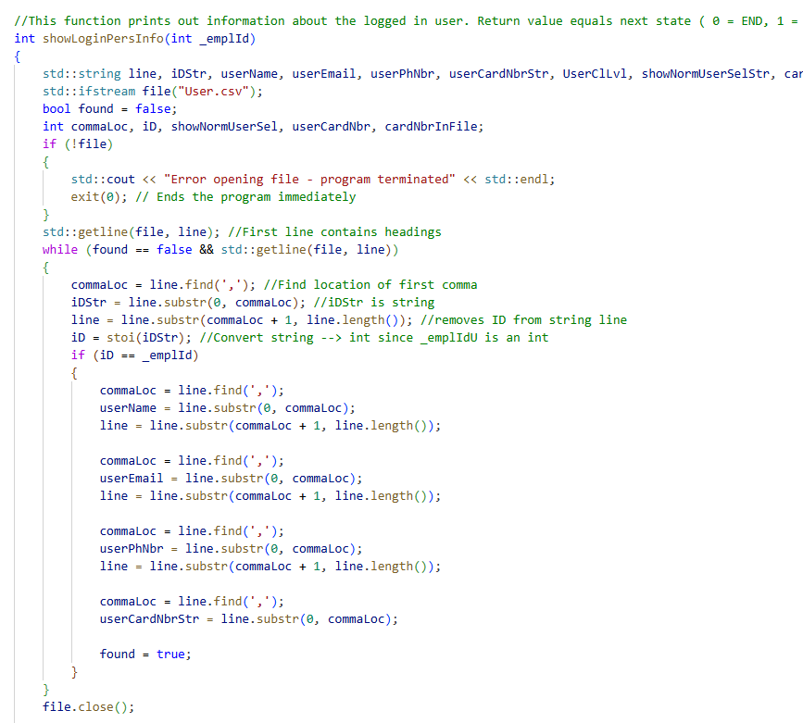
Example (part of) function

Slide 14
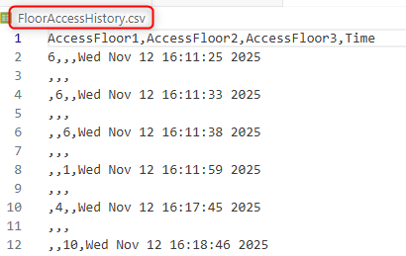
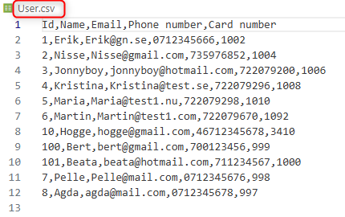
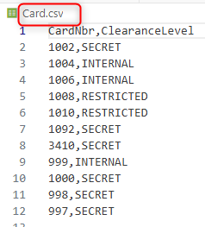
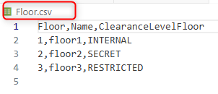

CSV files
A lot of file I/O because of selected concept

Slide 15
Future improvements
Use more references
Smaller and better structured functions
Some functions could be combined
Move some functionality from state machine into functions
Introduce OOP to reduce file I/O
Better fault handling, today program is executed if user input is incorrect etc
…big room for improvements…

